Slide 1

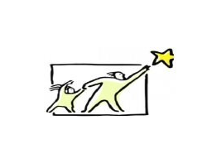
Barnardo’s SENDIASS
This resource has been created by Barnardo’s whilst they held the WESAIL contract 2018-2022 and edited for use by Barnardo’s SENDIASS Bradford.

Slide 2
This resource has been created by Barnardo’s whilst they held the WESAIL contract 2018-2022 and edited for use by Barnardo’s SENDIASS Bradford.

Slide 3


strong
feeling
of
being
upset
or
annoyed
This resource has been created by Barnardo’s whilst they held the WESAIL contract 2018-2022 and edited for use by Barnardo’s SENDIASS Bradford.

Slide 4
Things that we SHOULD NOT do when we are angry….
This resource has been created by Barnardo’s whilst they held the WESAIL contract 2018-2022 and edited for use by Barnardo’s SENDIASS Bradford.

Slide 5
Things that we SHOULD do when we are angry….
Let our anger out safely.
Try to feel calmer again.
This resource has been created by Barnardo’s whilst they held the WESAIL contract 2018-2022 and edited for use by Barnardo’s SENDIASS Bradford.

Slide 6
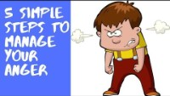
This resource has been created by Barnardo’s whilst they held the WESAIL contract 2018-2022 and edited for use by Barnardo’s SENDIASS Bradford.

