Slide 1
Barnardo’s WESAIL
This resource has been created by Barnardo’s whilst they held the WESAIL contract 2018-2022
Notes:
Explain that today’s assembly/presentation is about the Barnardo’s WESAIL service.
The rest of the slides explain everything else, so there is no need to expand on this here.

Slide 2
Who are they?
You might also hear WEASAIL being called SENDIASS.
SEND IASS
pecial
ducational
eeds
isability
nformation
dvice
upport
ervice
This resource has been created by Barnardo’s whilst they held the WESAIL contract 2018-2022
Notes:
Explain to children and young people that they might hear WESAIL being called SENDIASS. People mean the same thing.
Explain that the letters that spell SENDIASS stand for words that explain more about the service.
Click on the slide until the red letters spelling SENDIASS appear, then the accompanying pictures, but nothing else.
Explain that SEND is the first part of the word – ask children and young people if they have any ideas about what the letters might stand for. Tell them that the pictures on the slide might help. Encourage them to share their answers. Click to reveal the answers for the letters SEND only.
Tell children and young people that these words explain who WESAIL/SENDIASS help. The IASS part explains a bit about what they do.
Ask children and young people if they have any ideas about what the letters IASS might stand for. Tell them that the pictures on the slide might help. Encourage them to share their answers. Click to reveal the answers.

Slide 3
Who do they work with?
Children and young people who have….
Special Educational Needs
Disability
Need extra help with learning.
Physical or mental conditions that make it hard to do things. e.g. walk, speak, hear, see or learn.
This resource has been created by Barnardo’s whilst they held the WESAIL contract 2018-2022
Notes:
Explain more about SEND as follows:
SEN – extra help could include working in smaller groups to learn things, having an assistant in class, etc.
Disability – this can be disabilities that people are born with, or things that develop as a result of an illness or injury.

Slide 4
How many children and young people in UK schools have SEND?
1.3
million
This resource has been created by Barnardo’s whilst they held the WESAIL contract 2018-2022
Notes:
Tell children and young people that they are not alone if they have SEND – more than 1.3 million children and young people in schools in the UK do.
Explain that 1.3 million is about 15% of children in UK schools. That is around 5 children in every class of 30.

Slide 5
What do they do?
This resource has been created by Barnardo’s whilst they held the WESAIL contract 2018-2022
Notes:
Reinforce to children and young people that that having SEN or a disability might mean that they need some extra help with their learning, as well as other things like health.
Knowing what help is there, and how to get it, is where WESAIL/SENDIASS comes in! That’s the IAS (information, advice and support) part.
Show the video clip (from the Council for Disabled Children) that explains about IAS services. It is a YouTube hyperlink so you will need internet access. Stop the video at 1 minute 36 seconds.

Slide 6
What can they help you with?
School or college
Health
Social care
Having your say
This resource has been created by Barnardo’s whilst they held the WESAIL contract 2018-2022
Notes:
Use this slide with children and young people to recap and expand on the points that were raised in the video, explaining that WESAIL/SENDIASS can help them as follows:
School and college e.g. getting the extra support they need in school to learn things or planning what to do when they have finished school e.g. college, jobs, apprenticeships.
Health e.g. understanding more about their SEND or getting the specialist equipment that they need.
Social care e.g. getting help to do things at home or having a break away from their families.
Having your say e.g. telling adults what help they want or how they are feeling.

Slide 7
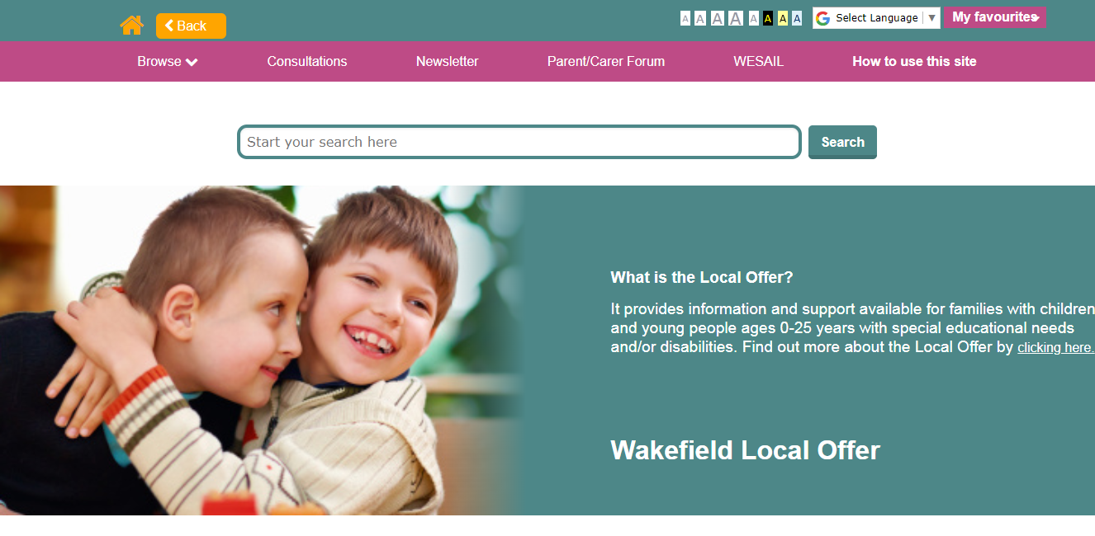
What else?
There’s the Local Offer website too….
This resource has been created by Barnardo’s whilst they held the WESAIL contract 2018-2022
Notes:
Explain that WESAIL/SENDIASS are also responsible for the Local Offer website, which has lots of information and advice on it for children and young people with SEND and their families in Wakefield. This includes information on things to do e.g. activities, clubs and groups.

Slide 8
Remember….
You have a right to get the information that you need
WESAIL/SENDIASS is FREE….
….and confidential
You can speak to them on your own, or someone else can help you
This resource has been created by Barnardo’s whilst they held the WESAIL contract 2018-2022
Notes:
Explain to children and young people that there are some really important points for them to remember.
Bring the points up one by one and expand as follows:
You have a right to get the information that you need – the law says this.
WESAIL/SENDIASS is FREE….- you don’t have to pay them any money to get their help.
….and confidential – they will keep what you tell them private. The only time that they can’t keep things private is if they are worried that you, or someone else, are not safe. Then they have to tell someone.
You can speak to them on your own, or someone else can help you – if you feel brave enough to speak to them on your own you can, but someone else can do it for you if that’s better for you.

Slide 9
Get in touch!
07961 897036
wesail@barnardos.org.uk
https://www.facebook.com/WESAILWakefield/
https://barnardossendiass.org.uk/wakefield-sendiass/
http://wakefield.mylocaloffer.org/
This resource has been created by Barnardo’s whilst they held the WESAIL contract 2018-2022
Notes:
Go through the different ways in which children and young people can contact WESAIL/SENDIASS.
Explain that they can have an information sheet about SENDIASS that has all of these links on it. Tell children and young people how they can get a copy of this in your school or college. There is a link to the sheet, and a hard copy, in the Resource Pack. Or you can follow this link: https://barnardossendiass.org.uk/media/sfyfgqka/what-is-sendiass-info-sheet-for-young-people.pdf

