Slide 1
Barnardo’s Wakefield Services
WESAIL & CAPs
Steps to supporting you

Slide 2
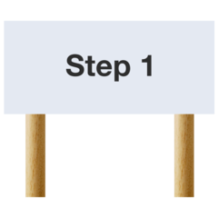
Sometimes children and young people need support to get their voice heard.
Step 1
We work together to help this happen
We have a “wishes & feelings sheet” that helps you tell us:
What is important to you
What you like
What you might need
This is sent with our waiting list letter or you can find it online
You can share your wishes & feelings with us about what you need help with
Look for the "Wishes and feelings" form

Slide 3
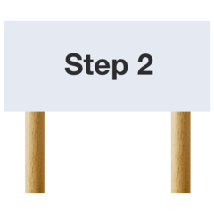
Step 2
When we get your form back we will think about how we could help you
We will decide together if you need an advocate. You can ask us for an advocate or we will suggest they may be helpful to you
If we think you do we will let you know by email or phone
If you want we can post things out to you
Step 3
We would then talk to you about what help you need. We will listen to you and decide together what is best

Slide 4
Step 4
We will decide together a time and a place where we can meet
We would talk about the next steps to support you
.
If you haven’t seen our leaflet about who we are the next slides tell you about our two services

Slide 5
The letters in WESAIL stand for
Wakefield Early Support Information and Liaison Service
SENDIASS is part of WESAIL
The letters in SENDIASS stand for Special Educational Needs and Disabilities Information, Advice and Support Service.
You can get help and information from SENDIASS if you have special educational needs or a disability.
Special educational needs means that you need extra help to learn things.
A disability is a physical or mental need that makes it hard to do things like walk, talk or see.
SENDIASS can help you with lots of things, like:
School or College
Health
Care

Slide 6
The letters in CAPs stand for
Children’s advocacy and participation service
What is advocacy?
Advocates are people who help you to work out what you want to say and how to say it
They will make sure you are listened to and involved in decisions
Advocates can help in lots of ways
They can : Help at meetings
Help explain things
Get answers for you
They can : Help you say what you think
Get answers to questions
Speak up for you

Slide 7
CAPs have independent visitors for children or young people who are in care
Children in Care means someone other than your mother or father is your parent
An independent visitor is a friendly adult
They will visit you and listen
They can help you and you can do activities together
Our independent visitor's are volunteers
A volunteer is someone who does not get paid
CAPs participate in events to help children and young people or to tell people what they do
Participate means to join or take part in

Slide 8
You can share your wishes & feelings with us about what you need help with
Look for the "Wishes and feelings" form
Find us on Facebook
WESAIL Wakefield
Wakefield CAPS - Children’s Advocacy
You can email us
WESAIL@barnardos.org.uk
wakefieldcaps@barnardos.org.uk
You can find out more online
Wakefield Sendiass (children & young people)
WESAIL on Local Offer
Wakefield CAPS (Children's Advocacy & Participation Service)

