Slide 1
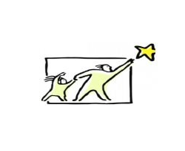
Barnardo’s SENDIASS
This resource has been created by Barnardo’s whilst they held the WESAIL contract 2018-2022 AND EDITED FOR USE BY Barnardo’s SENDIASS Bradford 2022.

Slide 2
Confidence and
self esteem
This resource has been created by Barnardo’s whilst they held the WESAIL contract 2018-2022 and edited for use by Barnardo’s SENDIASS Bradford 2022

Slide 3
B_l_ev_ _ g
i_
_ou_ _s_lf
a_d
y_ _r
_b_l_t_es
Believing
in
yourself
and
your
abilities
This resource has been created by Barnardo’s whilst they held the WESAIL contract 2018-2022 and edited for use by Barnardo’s SENDIASS Bradford 2022

Slide 4
My goals!
Goal | When do I want to do this by? | My reward for when it’s achieved!
Bake a cake
Sunday afternoon
Eat the cake!
This resource has been created by Barnardo’s whilst they held the WESAIL contract 2018-2022 and edited for use by Barnardo’s SENDIASS Bradford 2022

Slide 5
Celebrate your strengths and abilities
Set goals
Be positive
Look confident
This resource has been created by Barnardo’s whilst they held the WESAIL contract 2018-2022 and edited for use by Barnardo’s SENDIASS Bradford 2022

Slide 6
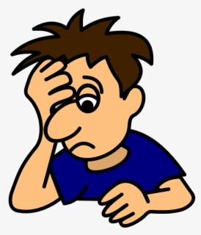
Someone has said something unkind to Tom.
What could he do to feel better?
This resource has been created by Barnardo’s whilst they held the WESAIL contract 2018-2022 and edited for use by Barnardo’s SENDIASS Bradford 2022

Slide 7
Tom has woken up feeling sad and upset.
What could he do to feel better?
This resource has been created by Barnardo’s whilst they held the WESAIL contract 2018-2022 and edited for use by Barnardo’s SENDIASS Bradford 2022

Slide 8
Tom didn’t do very well in his maths test.
What could he do to feel better?
This resource has been created by Barnardo’s whilst they held the WESAIL contract 2018-2022 and edited for use by Barnardo’s SENDIASS Bradford 2022

Slide 9
Tom’s friends have left him out by going to the cinema together without him.
What could he do to feel better?
This resource has been created by Barnardo’s whilst they held the WESAIL contract 2018-2022 and edited for use by Barnardo’s SENDIASS Bradford 2022

